Slide 1

Tex – The Tex Editor
Project by-
Al Masum Fahim
(12-02-04-027)
Farhana Yasmin
(12-02-04-045)

Slide 2
Course Info:
Course No: CSE 2100 Course Title: Software Development-II

Slide 3


Moderated by:
Ms. Monjura Afrin Rumi
Lecturer,
Ahsanullah University of Science & Technology

Slide 4
What is TextEditor/notepad?
Notepad is a generic text editor that enables someone to open and read plain text files. If the file contains special formatting or is not a plaintext file, it will not be able to be read on ‘tex-the text editor’.
Notepad is a plaintext editor and does not support pictures. This file is saved as .txt format

Slide 5
Project Description
In this project, we have made a Text Editor which is designed to provide the power and functionality to satisfy the most demanding text editing requirements.

Slide 6
Used Software
NetBeans IDE 7.1.1
JDK 7

Slide 7
Features
Word count
Column count
Line count
Search and find option
Cut & paste capabilities

Slide 8
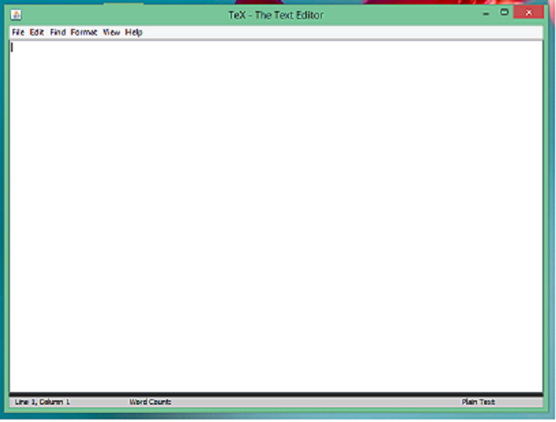
First look:

Slide 9
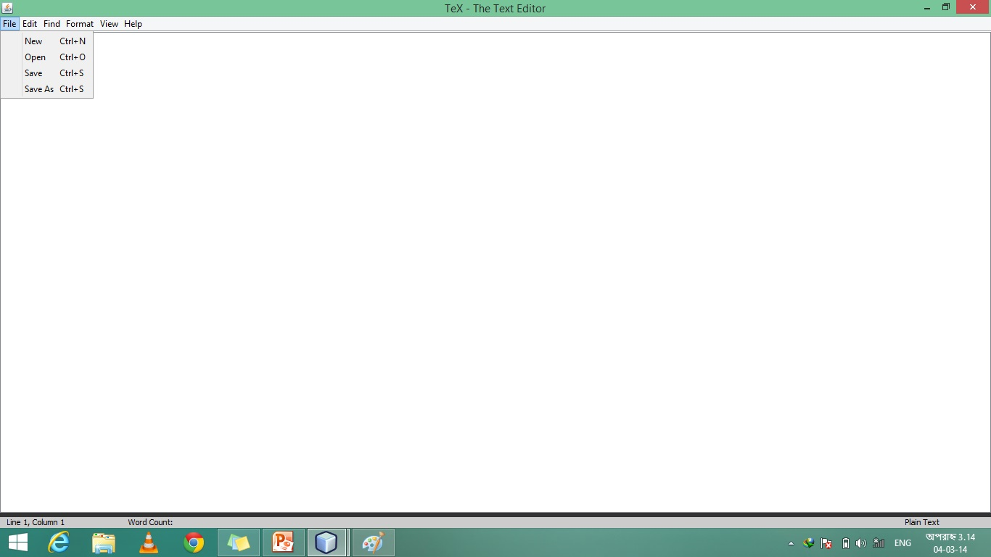
Menu page

Slide 10
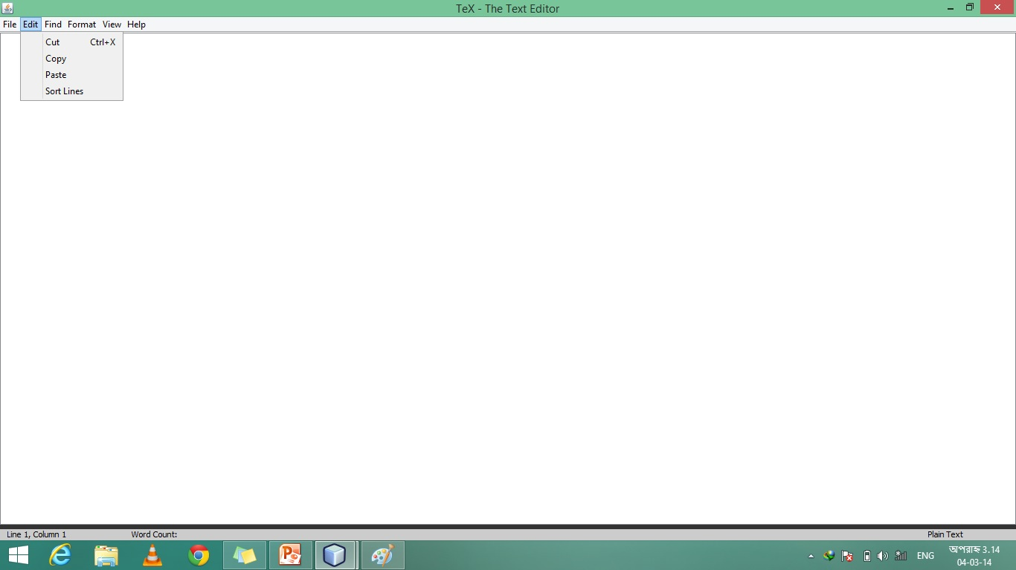
Edit page

Slide 11
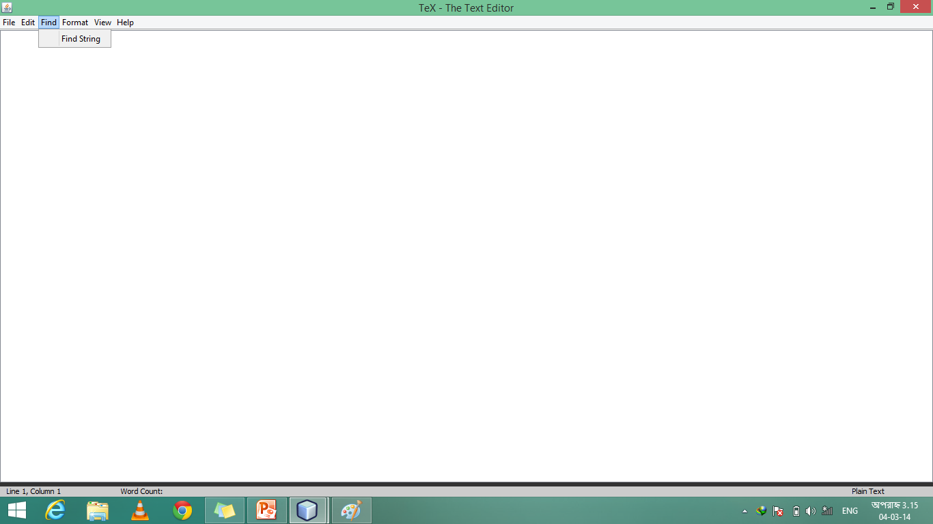
Search and find:

Slide 12
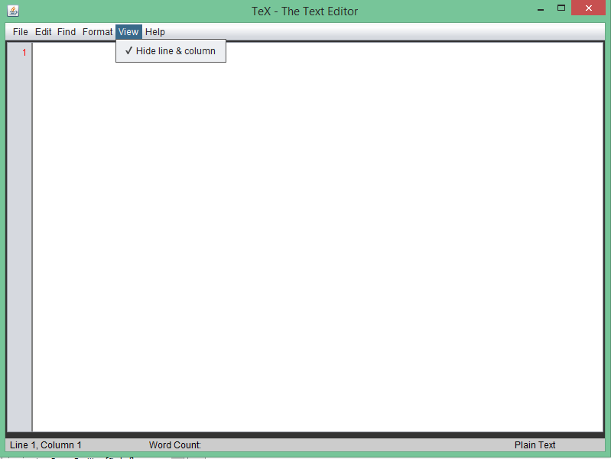
View:

Slide 13
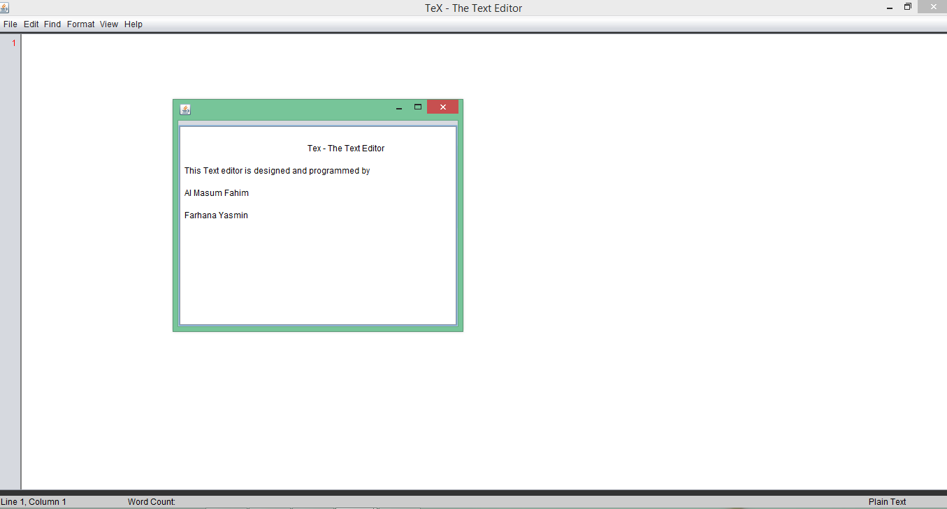
Help:

Slide 14
Summarized details
By using this textpad you will be able to do the following things:
Writing any kind of text
Plain text
HTML text
Website’s link etc.
Searching and finding a sentence or word
Sorting etc.

Slide 15
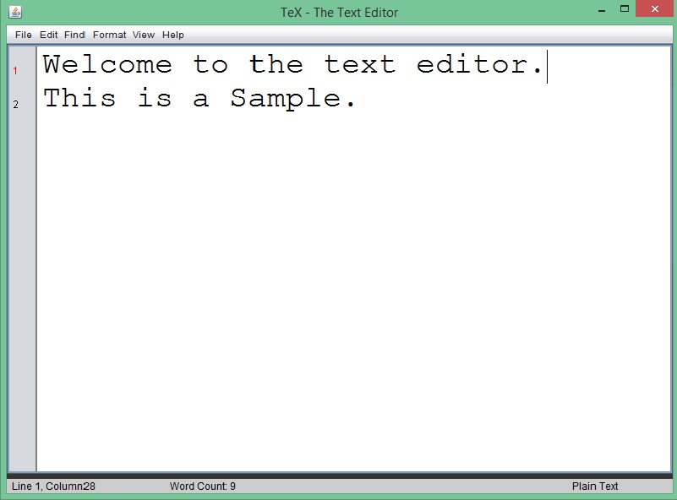
Textpad in use

Slide 16
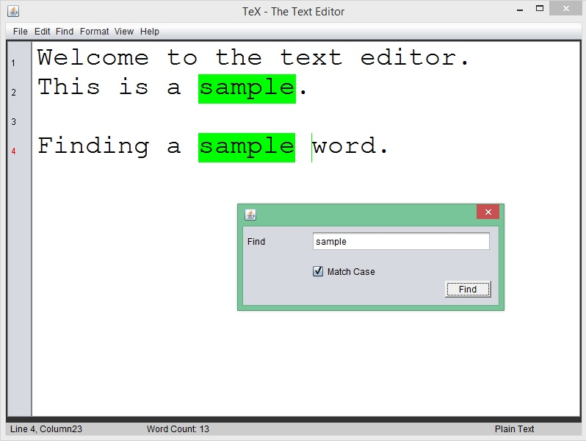
Textpad in use - 2

Slide 17
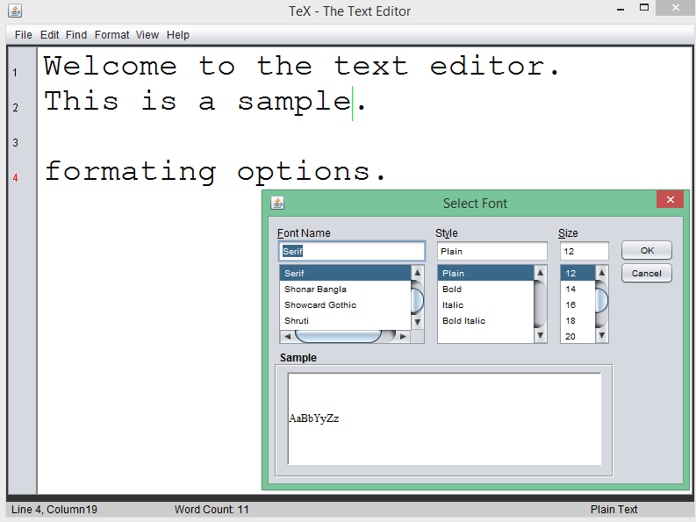
Textpad in use - 3

Slide 18
Conclusion
We hope everyone enjoyed what you just saw right now. The program is quite easy to understand and even easier to operate.
We hope the program will be really helpful for everyone. Thanks a lot for giving us the valuable time of yours and listening to this presentation

Slide 19

Thanks a lot.

